Slide 1


ARE MARKETING/ PROMOTIONS PLANS AFFECTING THE SALES UNIT?

Slide 2
WE CAN CLEARLY SEE THAT THERE HAVE AN INCREASE THE UNIT SALES PER YEAR

Slide 3
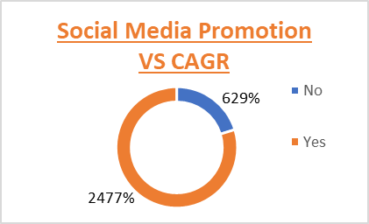
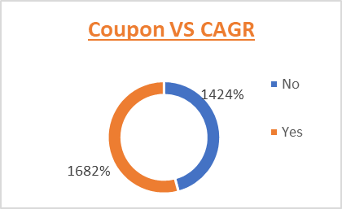
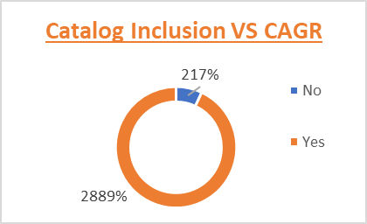
Key point, observation or data here…
WE CAN NOTICE THAT THERE NO INCREASE IN SALE BY PROMOTING THROUGH POSTERS
OTHERS HAVE SIGNIFICANTLY COMTRIBUTED FOR INCREASE IN SALES AND MAXIMUM CONTRIBUTION IS THROUGH CATALOG INCLUSION

Slide 4
Summary
SOCIAL MEDIA AND CATALOG INCLUSION ARE SIGNIFICANTLY INCREASING THE UNIT SALE PER YEAR
THEREFORE
MORE AFFORT SHOULD BE GIVEN IN PROMOTING THE SALES THROUGH SOCIAL MEDIA AND CATALOG INCLUSION AND PROVIDING MORE AND MORE OFFERS AND DISCOUNT THROUGH THESE ATTRACTING PROMOTIONS

